Slide 1
The Science of Psychology

Slide 2
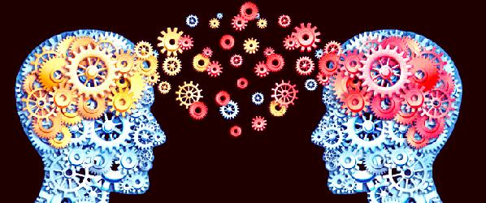
What is Psychology?
It’s the study of human behaviors and mental processes.
Describe, Explain, Predict.

Slide 3
Knowledge
All knowledge comes from somewhere
Knowing the source of knowledge is just as important as the knowledge itself.
Many areas of psychology
Clinical/counseling, social, cognitive, neuroscience, developmental, and more
All united by the same basic set of research methods.

Slide 4
Sources of Knowledge
Tradition
“We believe it because people have always believed it”.
Traditionally, teachers could hit students
Not anymore, because we know that rewards work better than punishment.
Traditionally, teachers make students write papers and take exams
We still do, because evidence shows that papers and exams help to promote learning.
Tradition doesn’t make something true, but it doesn’t make something automatically false, either.

Slide 5

Sources of Knowledge
Common sayings
“Opposites attract”
“Birds of a feather flock together!”
Just because something is catchy or memorable that doesn’t mean it’s true

Slide 6

Sources of Knowledge
Intuition
Guts, emotions, instincts
Not always empirical

Slide 7

Sources of Knowledge
Authority
Believing someone because they are smart or powerful
Think parents, doctors, politicians
Sigmund Freud: “Most people do not really want freedom, because freedom involves responsibility, and most people are frightened of responsibility”.

Slide 8

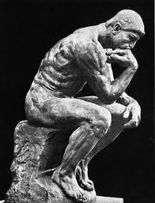
Sources of Knowledge
Rationalism
Using logic and reason to acquire knowledge.
Example: All dogs have a good sense of smell. Tucker is a dog. Therefore…

Slide 9
Understanding Science
Psychology is a science!
Science deals with three main things:
Systematic empiricism
Empirical questions
Public Knowledge
Generating New Knowledge
Scientific Method
Process by which we conduct research and learn things. This roughly follows a series of steps (next video)

Slide 10
Understanding Science
We aren’t talking about pseudoscience here…
Falsifiability
The ability for a theory or hypothesis to be proven wrong.
Extrasensory Perception as an example.
Other examples
Biorhythms, astrology, graphology, magnetic therapy for pain.
Distinguish pseudo psychology from scientific psychology

Slide 11
Goals of Science
Describe
Learn, make observations, test, perform literature reviews
Predict
Find a relation between two things – predict new occurrences.
Explain
Determine the cause of behavior (e.g. mechanism of something)

Slide 12
Different Types of Science
Basic Research
Research for the sake of knowing, or to gain an accurate understanding of an area of science.
How did the universe begin?
What is the genetic code of an animal?
How do memories work?
Applied Research
Research conducted to address a practical problem
Cell phones and driving
Disease

Slide 13
Use your common sense!
Why do we even need to use the scientific method for psychology?
Beliefs using intuition or common sense – folk psychology
A lot of the time our intuitions are correct.
But not always…
Most people believe that anger can be relieved by “letting it out”, by punching something or screaming.
However, research indicates that this tends to leave people feeling more angry, not less (Bushman, 2002).
Myths about psychology (Lillienfeld et al., 2010)
People use only 10% of their brains
Most people experience a midlife crisis in their 40s-50s
Psychiatric admissions and crimes increase during full moons.

Slide 14
How can we get this wrong?
We often rely on mental shortcuts (heuristics) when forming and maintaining our beliefs.
Confirmation bias. We tend to seek out information consistent with our beliefs, and disregard information that is inconsistent with our beliefs.
We are all susceptible to these heuristics.
Even scientists
Scientists remain skeptical, remain tolerant about “unknowables”, and use evidence as a safeguard against our biases.
https://www.youtube.com/watch?v=Eut8jMfSA_k&feature=youtu.be

Slide 15
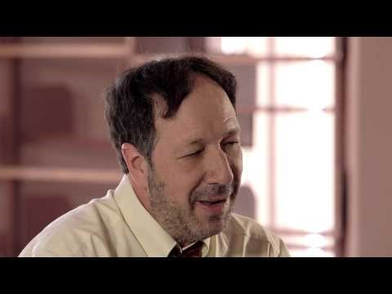

Slide 16
Conclusions
What are the different sources of knowledge? Can you think of new examples of each of these?
What are some of the benefits and limitations of each of these sources of knowledge?
What are the 3 main aspects related to understanding and performing science?
What is falsifiability, and how does that relate to pseudoscience?
What are the goals of science?
What are the two main types of research?
What is one reason why our intuitions or beliefs can lead us astray?

